Slide 1
20-3 IPv6
The network layer protocol in the TCP/IP protocol suite is currently IPv4. Although IPv4 is well designed, data communication has evolved since the inception of IPv4 in the 1970s. IPv4 has some deficiencies that make it unsuitable for the fast-growing Internet.
Topics discussed in this section:
Advantages
Packet Format
Extension Headers
20.<number>

Slide 2
IPv6: Advantages
Larger address space.
Better header format.
New options.
Allowance for extensions.
Support for resource allocation.
Support for more security.

Slide 3
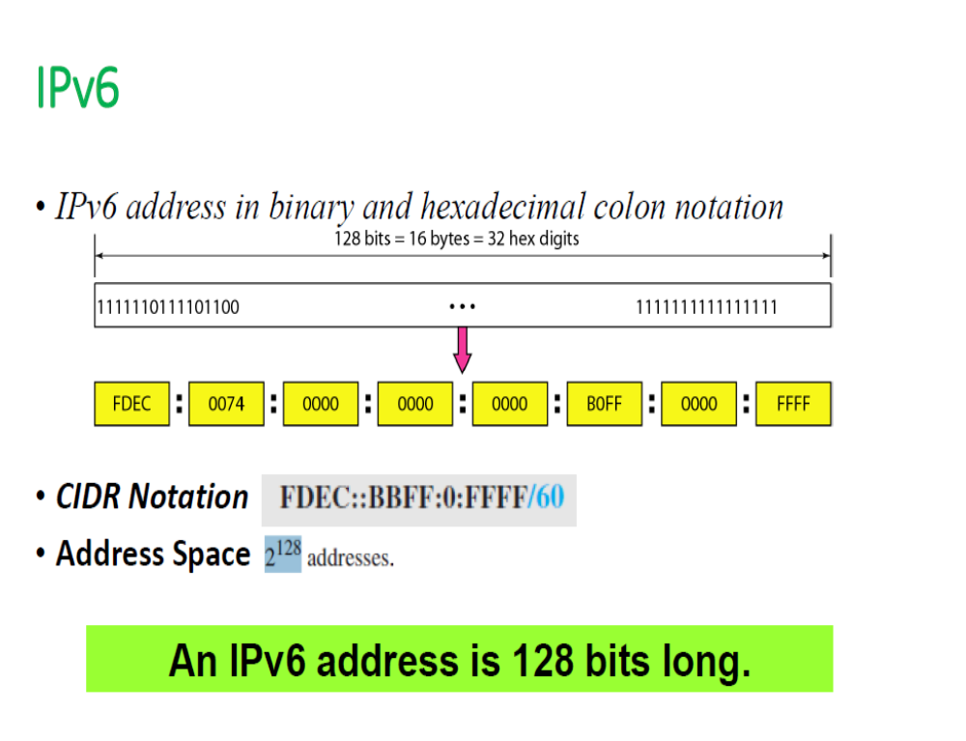
20.<number>

Slide 4
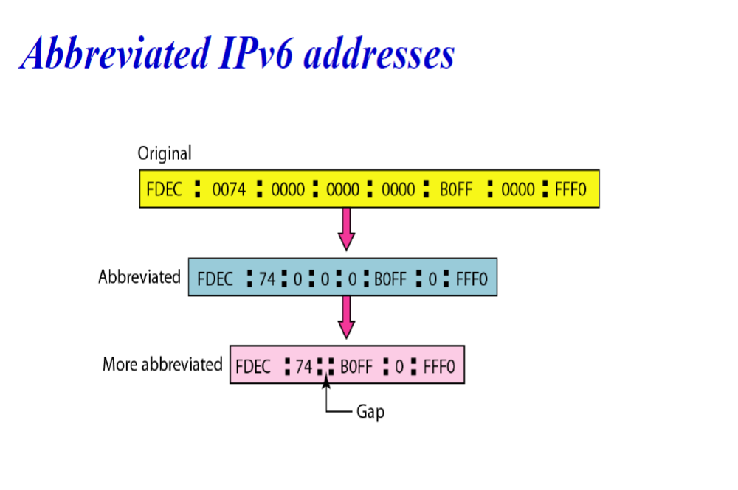
20.<number>

Slide 5
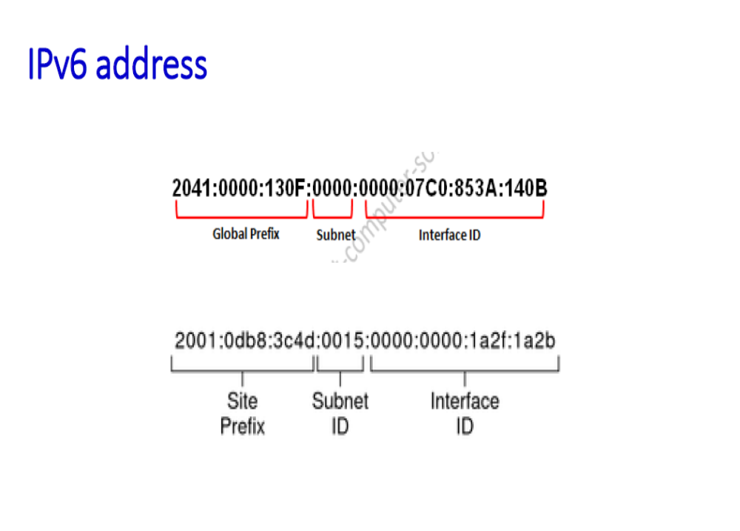
20.<number>

Slide 6
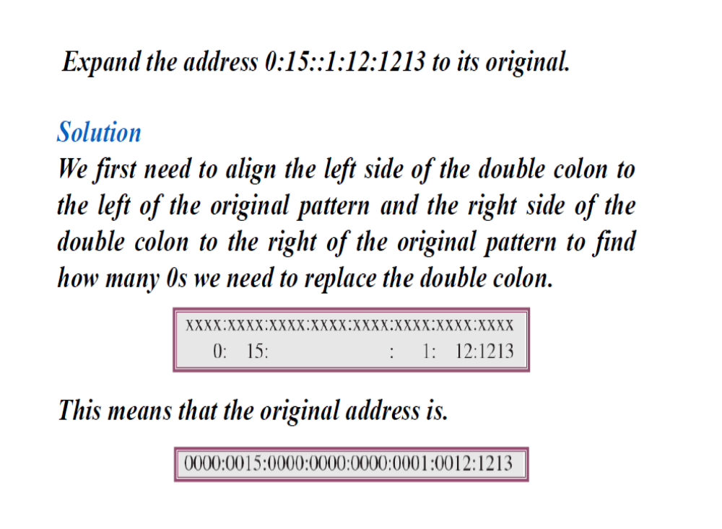
20.<number>

Slide 7

Figure 20.15 IPv6 datagram header and payload
20.<number>

Slide 8

Figure 20.16 Format of an IPv6 datagram
Priority
Protocol
20.<number>

Slide 9

Table 20.9 Comparison between IPv4 and IPv6 packet headers
20.<number>

Slide 10
20-4 TRANSITION FROM IPv4 TO IPv6
Because of the huge number of systems on the Internet, the transition from IPv4 to IPv6 cannot happen suddenly. It takes a considerable amount of time before every system in the Internet can move from IPv4 to IPv6. The transition must be smooth to prevent any problems between IPv4 and IPv6 systems.
Topics discussed in this section:
Dual Stack
Tunneling
Header Translation
20.<number>

Slide 11

Figure 20.18 Three transition strategies
20.<number>

Slide 12

Figure 20.19 Dual stack
Host uses DNS query result to determine which IP to use
20.<number>

Slide 13

Figure 20.20 Tunneling strategy
Popular used right now in many countries
20.<number>

Slide 14

Figure 20.21 Header translation strategy
20.<number>

